Slide 1
Academic Networks
IUS Education Group
Electronic Network (RECAL)
IUS Interculturality Network (RIUSI)
CIAGEN

Slide 2
Academic Networks
One of the Commitments of our Networks is to “offer the general guidelines that facilitate each university academic community the opportunity to develop its own Salesian cultural-scientific-technological-educational and pastoral project”, in order to motivate the contributions and relationships between the IUS

Slide 3
Electronic Network (RECAL)
RECAL is an academic network supported by experts in the field of electronics that seek to strengthen research, teaching, innovation, and social development in Latin America through collaboration and projects between Salesian institutions.
Universidad Católica Don Bosco (Brasil)
Universidad Politécnica Salesiana (Ecuador)
UNISALES (Brasil)
UNILESTE (Brasil)
EUSS (Barcerlona)

Slide 4
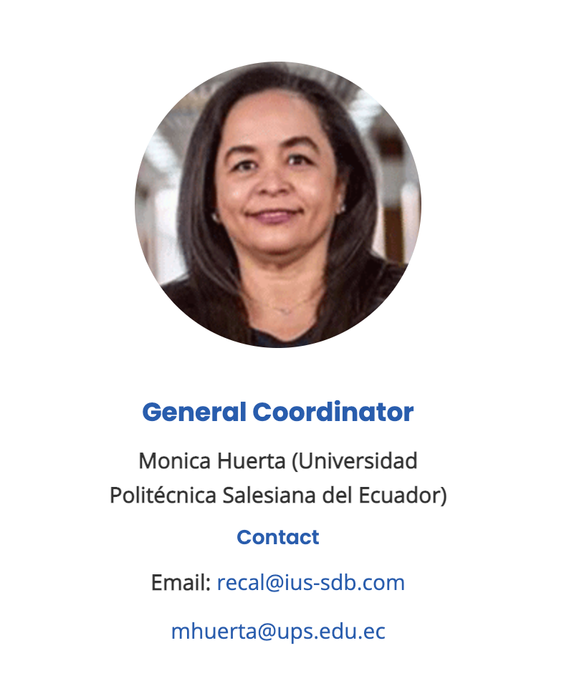

Slide 5
Electrical and Smart Cities Network (RECI)
Networking, knowledge, and teamwork allow the RECI network to generate professional and applied research that pushes boundaries and seeks to respond to the needs in the scientific community of electricity networks and smart cities in countries where the IUS reside.
UPS
Don Bosco
UNISALES
UNILESTE
EUSS-BARCELONA

Slide 6
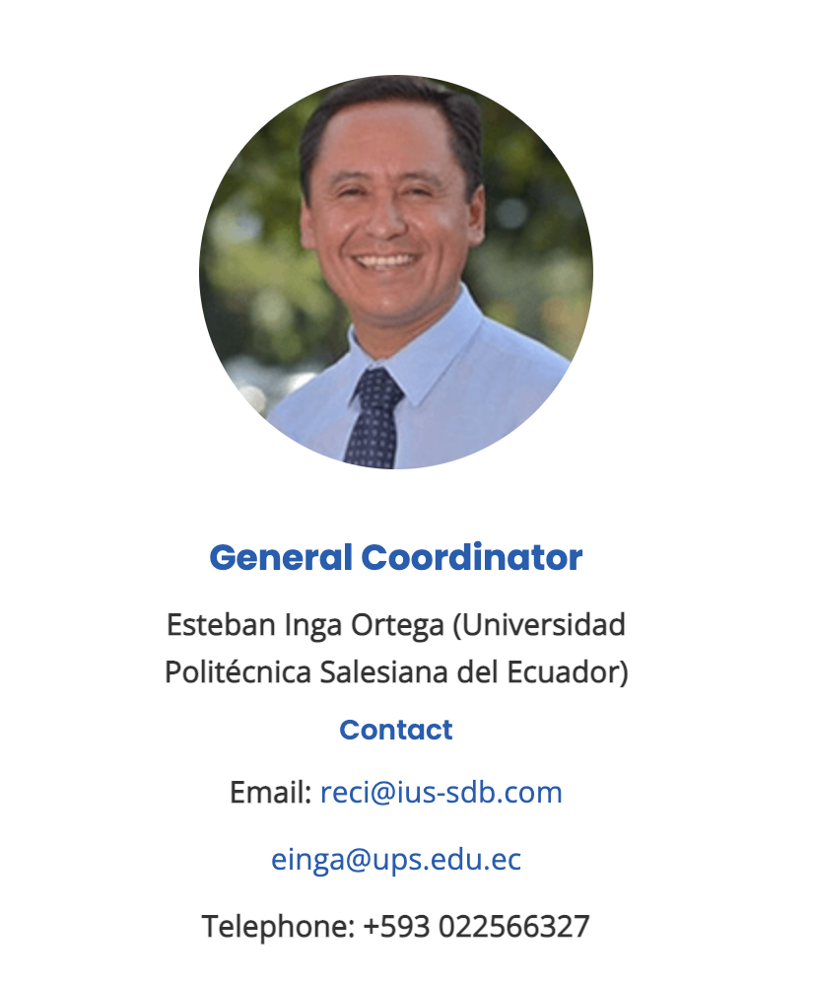

Slide 7
IUS Interculturality Network (RIUSI)
The Interculturality Network focuses on producing Social and Cultural impact through academic collaboration in areas of youth, human rights, environmental protection, ecumenical and religious dialogue, and intercultural relations.
Universidad Politécnica Salesiana (Ecuador)
Universidad Católica Silva Henriquez (Chile)
Universidad Católica Don Bosco (Brasil)

Slide 8
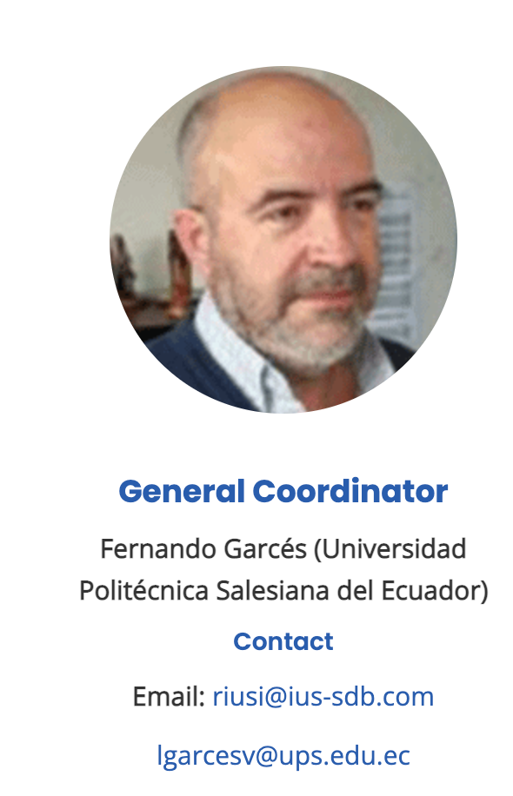

Slide 9
Electrical and Smart Cities Network
Through collaboration with universities, CIAGEN engages in discovering and creating collaborative projects in the Administrative and Economic Sciences areas that will respond to society’s problems, especially those that affect the most vulnerable sectors.
Universidad Católica Don Bosco (BR) Universidad Politécnica Salesiana (Ecuador)
Universidada Católica Silva Henriquez
Universidad Salesiana Bolivia

Slide 10
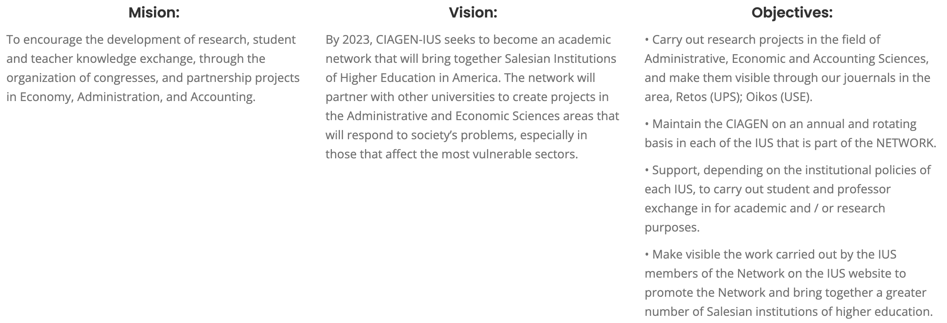
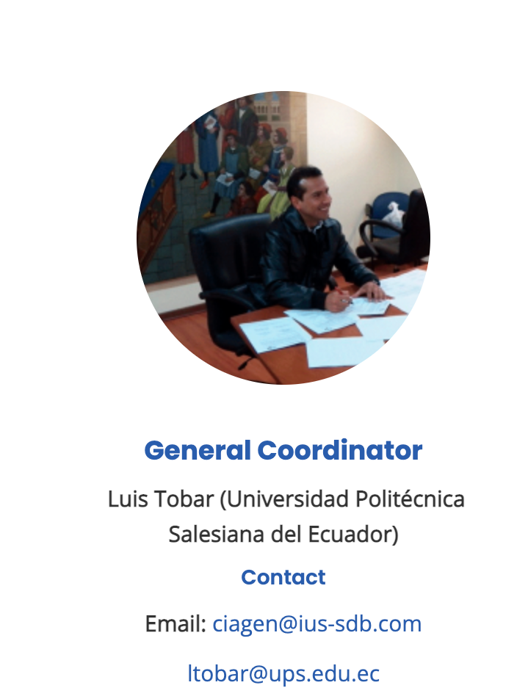

Slide 11
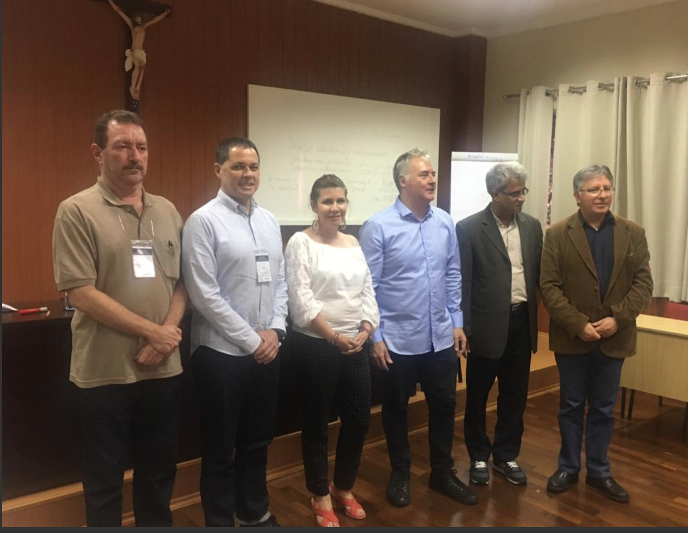
IUS EDUCATION GROUP

Slide 12
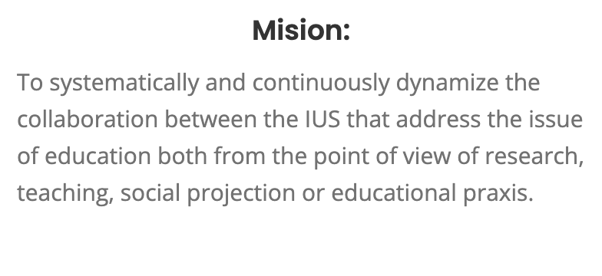
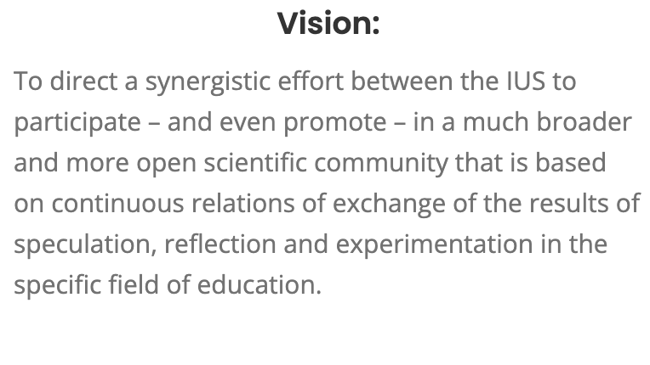
Immersed within a community full of experts worldwide, the IUS Education group seeks to combine the efforts between institutions to participate and promote a greater and more open scientific Community in the field of education.

Slide 13
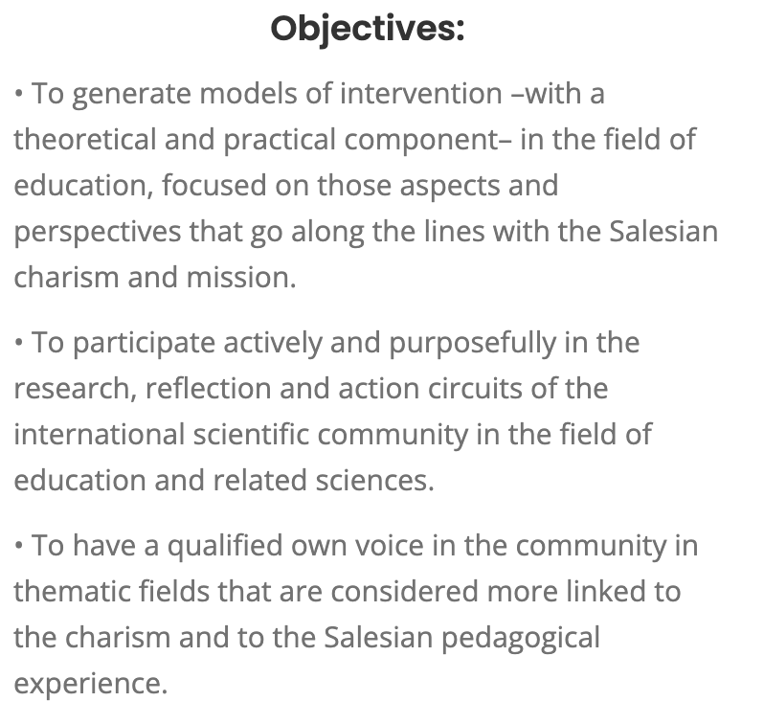
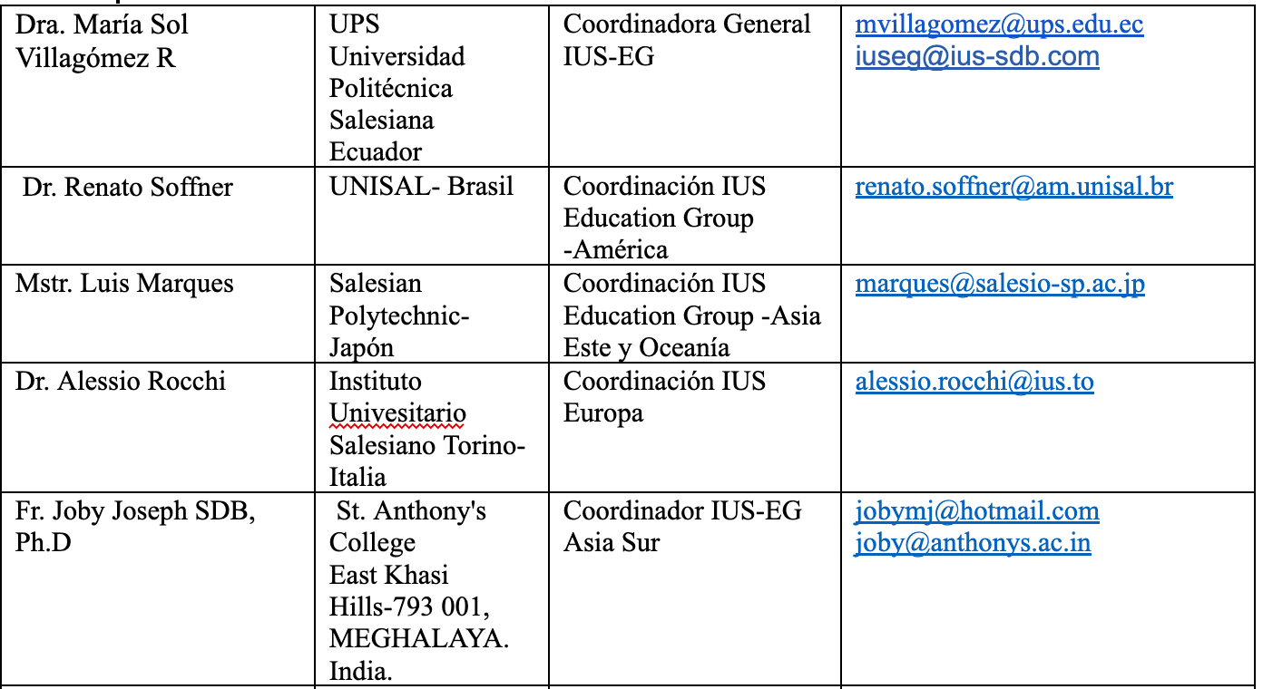
Centro de Enseñanza Superior Don Bosco Madrid España
Universidad Católica Silva Henriquez Santiago de Chile
Universidad Don Bosco San Salvador
UNISAL Sao Paulo Brasil
Instituto Superior Don Bosco Rosario Argentina
Universidad Salesiana de Bolivia La Paz Bolivia
Universidad Católica Don Bosco Campo Grande Brasil
UNISALESIANO Lins Aracatuba Brasil
Universidad Católica de Brasilia Brasil
Unileste- MG Centro Universitario do Leste de Minas Gerais Brasil
UNISAL- Centro Universitario Salesiano de Sao Paulo Brasil
Universidad Politécnica Salesiana del Ecuador
Universidad Mesoamericana Ciudad de Guatemala Guatemala
Universidad Salesiana de México México DF
Instituto Universitario Salesiano P. Ojeda Los Teques Venezuela
Salesian College Sonada, West Bengal, India
Don Bosco College, Azara India
Don Bosco College Maram Dimapur India
Sacred Heart College Tirupattur, Tamil Nadu India
Don Bosoc College, Caubang Philippines
Scuola Superiro Internaz Sciencza Educaczione Venezia Italia
Salesian Politecnich Tokio.

Slide 14
Organizing instrument Scientific seminars every three years General Assembly
a) regularly put on the table educational issues of importance in society;
b) address such issues in their theoretical and practical dimension;
c) stimulate the institutions and people of the «IUS Education Group» in the regular practice of research, in the constant improvement of the quality of scientific work and in its repercussion and social incidence;
d) crystallize into a scientific community that works synergistically in a network (Declaration, 2007).

Slide 15
COMMON ACTION PLAN (2018-2021)
1. KNOWLEDGE PRODUCTION:
Objective: Assume projects, programs, common actions of innovation, research and dissemination
Result: Collaboration of two or more IUS in carrying out innovation, research and dissemination action.
2. NETWORKING:
Objetive
Create conditions for joint action and interaction within the IUS Education Group
Strengthen and encourage the participation of the South Asia, East Asia and Oceania1 areas. KNOWLEDGE PRODUCTION:
and Africa
Result: Construction of spaces for academic and cultural collaboration
3. COMMON ACTION
Objetive
Demonstrate the joint operation of the IUS Educatión Group
Result: Planning and realization of some common action for the areas (Europe, South Asia, East Asia and Oceania).

Slide 16
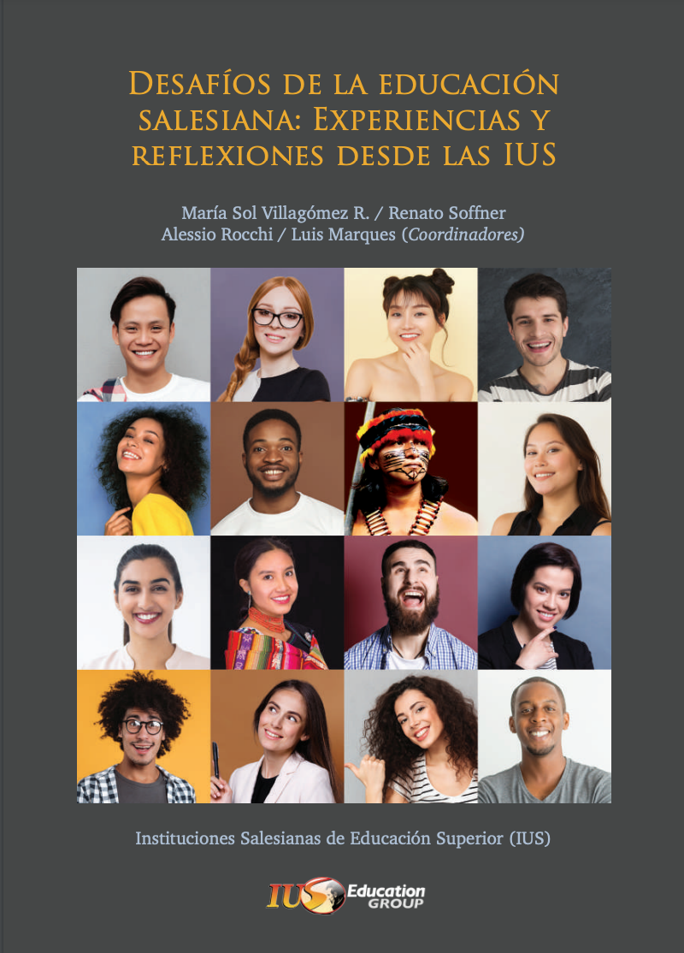
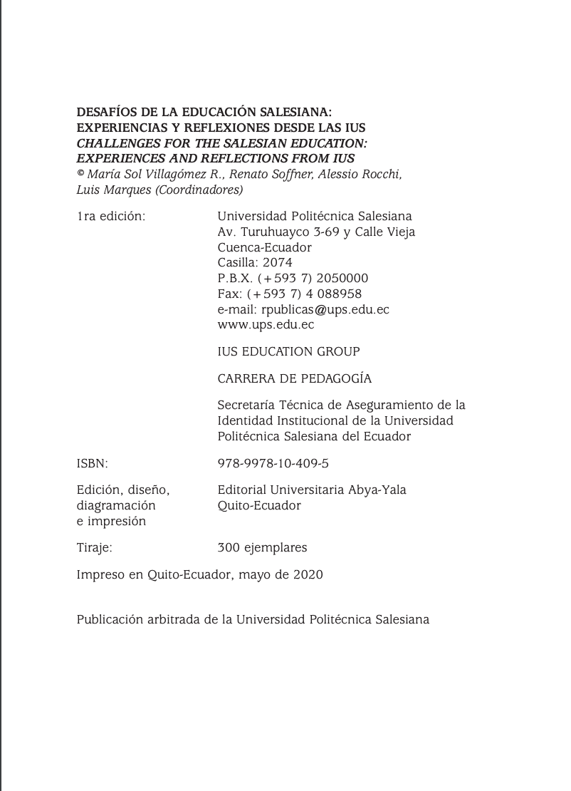
Achievements
Book publication: CHALLENGES FOR THE SALESIAN EDUCATION: EXPERIENCES AND REFLECTIONS FROM IUS
Capítulo I
FORMACIÓN HUMANA, PASTORAL Y JUVENTUD
Capítulo II
INNOVACIÓN EDUCATIVA
Capítulo III
EDUCACIÓN, DIVERSIDAD E INTERCULTURALIDAD
https://ius-sdb.com/challenges-for-salesian-education-experiences-and-reflections-from-ius/

Slide 17
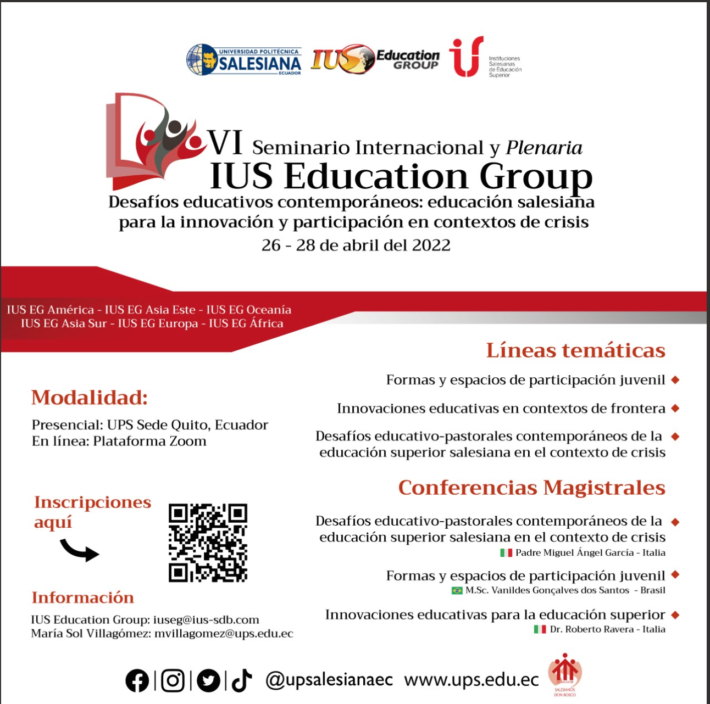
Achievements
VI International Seminar IUS Education Group
General Objective
To generate a space for reflection on the contemporary educational challenges of the IUS that participate in the Education Group.
https://ius-sdb.com/vi-international-seminar-ius-education-group/

Slide 18
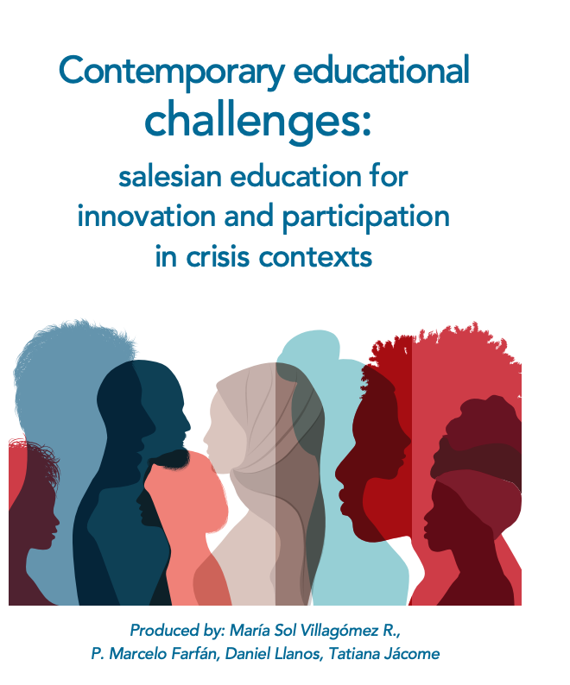
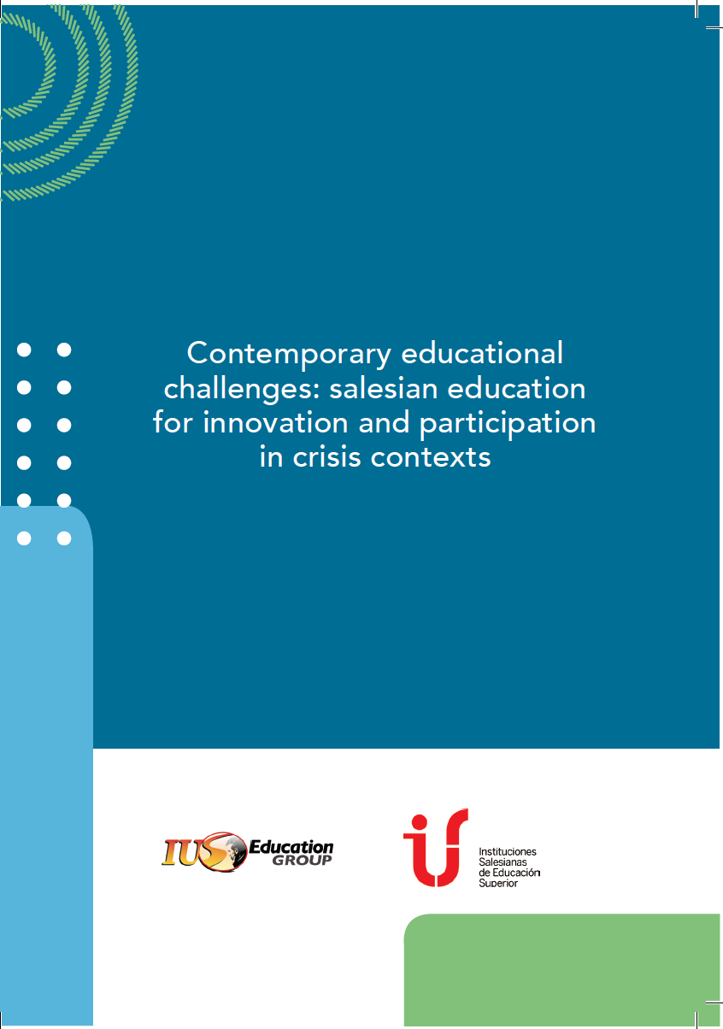
Research
Contemporary educational challenges: Salesian education for innovation and participation in crisis contexts.
26 IUS from America, Africa, Europe and Asia participate

Slide 19
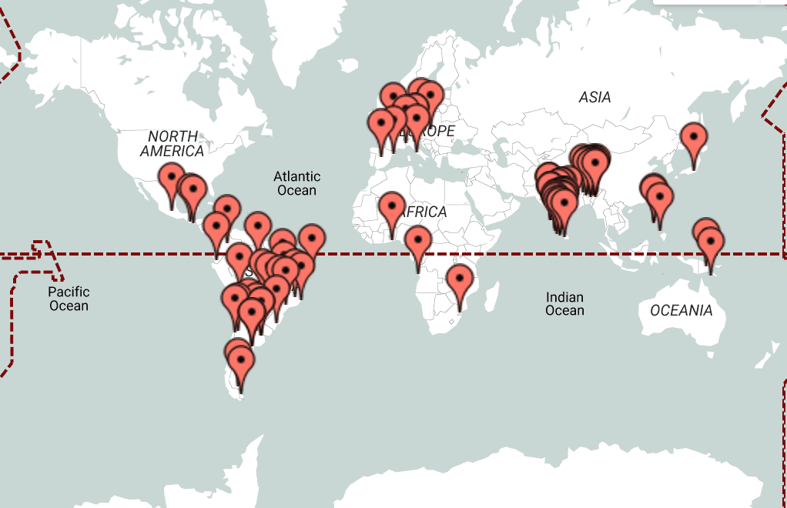
IUS

